Slide 1

Dojo infra structure
  Themes, require and more

Slide 2

Dojo infra structure
Lesson Content:
    Themes and theme customisation
    dojo.require
    compression tools.
    dojo.addOnLoad.
    Debugging Dojo applications.

Slide 3

Themes in Dojo
Dojo comes with three themes out of the box: Tundra (which we have been using), Soria and Noir.
A small project can just go ahead and use them customizing as it goes along.
A big project will kick off by defining a new theme and using it across the board.

Slide 4
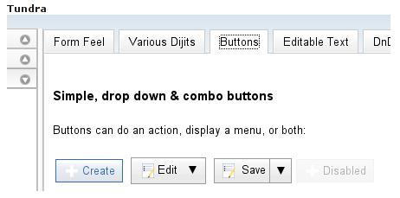
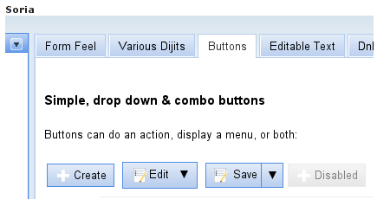
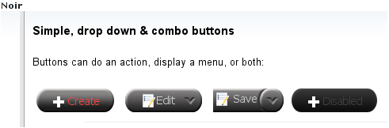
How do they look ?

Slide 5
Themes in Dojo (cont)‏
Doing a theme from scratch in Dojo is difficult.
Tundra is 4689 lines of highly delicate CSS code! Do you want to write it from scratch?
Is there another way? Yes!
Start with a standard theme (one of the three) and customize.

Slide 6
Customizing a Dojo theme
Decide what you are unhappy with.
Find it in your themes css files (e.g. $DOJO/dijit/themes/tundra/tundra.css).
Add your own CSS file and only adjust the difference.
Include your own CSS in each page after tundra or create your own CSS which does both.

Slide 7
Example of customization
My CSS file:
.yellowForm .dijitButton, .yellowForm .dijitTextBox { background: yellow; }
.blueForm .dijitButton, .blueForm .dijitTextBox { background: blue; }

Slide 8
Example of customization
Borrowed shamelessly from tundra.css:
.tundra .dijitTextBox,
.tundra .dijitComboBox,
.tundra .dijitSpinner,
.tundra .dijitInlineEditor input {
background:#fff

Slide 9
Customization (cont)
At the <head>:
<style type="text/css">
@import "/dojo/dojo/dijit/themes/tundra/tundra.css";
@import "/dojo/dojo/dojo/resources/dojo.css";
@import "/dojo/ex3/my.css";
</style>

Slide 10
Customization (cont)
And in the HTML <body>:
<body class="tundra">
<div dojoType="dijit.layout.TabContainer">
<div id="kh" dojoType="dijit.layout.ContentPane" class="yellowForm" title="Linux kernel hacking" selected="true">

Slide 11
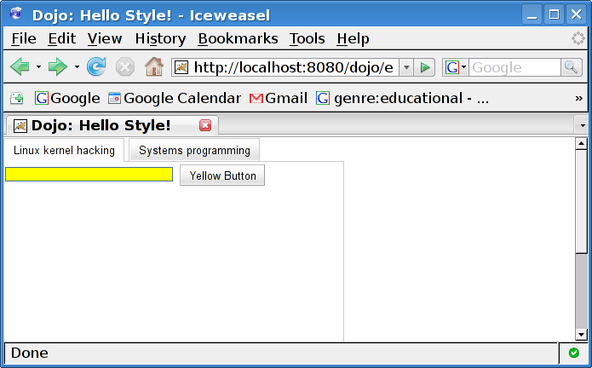
Customization (cont):
And the amazing result:

Slide 12
Dojo.require
Dojo is made up of many many packages.
It would make no sense to include tons of Javascript code which you do not use.
On the other hand it would not make sense to hard code Javascript file names in every HTML file you write.
This is a Javascript defect of not having a logical “import” feature.

Slide 13
Dojo.require (cont)
Dojo.require is the solution to all of these.
You only <script> dojo.js for then on you use dojo.require
This keeps your code logical.
Dojo.require is protected against two time includes.
Dojo.require is dependency aware with regards to widgets and all! Wow!

Slide 14
Dojo.require (cont)‏
Dojo.require is just a Javascript function and hence can be called at any time (even in a Javascript loop!)‏
However, Dojo.require does Ajax with the server and so is synchronous and slow!
It is standard practice to only use Dojo.require at the <head> of the HTML once for each feature used.

Slide 15

Dojo.require (cont)‏
All package names are case sensitive!
Correct use of Dojo.require will also make most of your code agnostic to the location of dojo on the server.
<head>
<script type="text/javascript">
dojo.require("dijit.layout.TabContainer");
dojo.require("dijit.layout.ContentPane");
</script>
</head>

Slide 16
Custom build
Dojo applications are heavier on the client than traditional AJAX applications
dojo.require alleviates some of the problem in that every page does not load the whole of Dojo
But every page still calls back home many times per each dojo.require!
This is too much overhead

Slide 17
Custom build (cont)‏
The Dojo solution is to “compile” special versions of your Javascript files using profiles and produce dense, single files so that they will not trigger any more XHRs
The tool to do this is Java with a special program
This needs to be done at deployment time

Slide 18
Dojo.addOnLoad
Many Javascript programmers want to do something when the page loads
Different browsers handle this a little differently
In addition we don't want to step on someones toes
In Dojo we have to make sure to do this after the Dojo parse phase

Slide 19
Dojo.addOnLoad
Dojo.addOnLoad allows us to register a function to be executed after the Dojo parse phase:
<script type="text/javascript">
function init(){
alert("At load of page right after Dojo parse");
}
dojo.addOnLoad(init);
</script>

Slide 20
What can you do on load?
Connect events
Create widgets
Get data from server and populate widgets
Start effects (fade in, out,...)‏
Hack into the users bank account
You get the drift...

Slide 21
Debugging Dojo applications
Debugging AJAX applications is a major drag.
Alert() is over used, requires manual intervention, has no debug levels and cannot be turned off in production
The mix of CSS, AJAX, server side, Browser incompatibilities, DOM and Javascript makes debugging really hard!

Slide 22
Firebug to the rescue
Firebug is a JavaScript debugger for debugging client side browsers.
It is an add-on to Firefox
It debugs source, Javascript, the DOM tree, the CSS rules, provides console and more
It provides a cool user interface
Alas, no version for IE

Slide 23
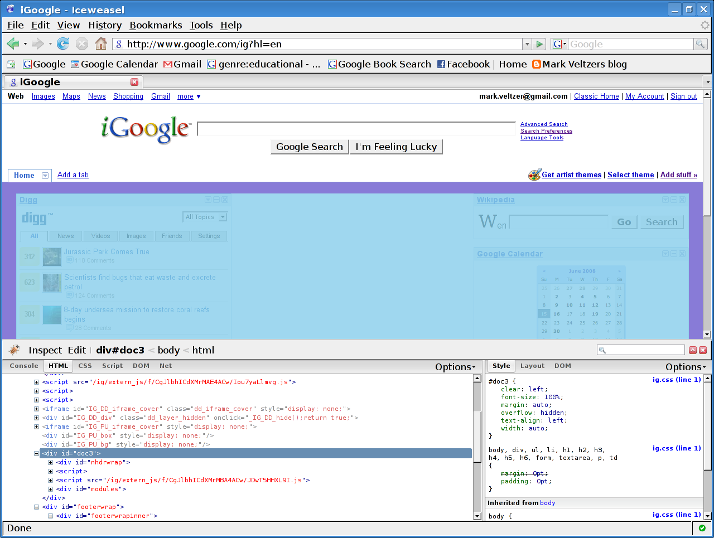
Firebug to the rescue

Slide 24
Firebug lite to the rescue
Firebug is a standalone JavaScript library for debugging client side browsers.
It can be used with any toolkit and with any most browsers.
It mimics the features of firebug and provides a user interface
It provides a programmatic interface which is flexible.

Slide 25
Firebug lite to the rescue
Put in “djConfig="parseOnLoad: true, isDebug: true"
This will cause firebug lite to kick in
Now use console.debug([msg]) anywhere in your application.
If isDebug is false then these calls will not have much overhead

Slide 26
Firebug lite (example)‏
Adding the debug flag:
<script type="text/javascript" src="/dojo/dojo/dojo/dojo.js" djConfig="parseOnLoad: true, isDebug: true">

Slide 27
Firebug lite (example)‏
Now some code which does debug:
<script type="text/javascript">
var i=1;
function helloPressed() {
console.debug("the button was clicked "+i);i++;
}
</script>

Slide 28
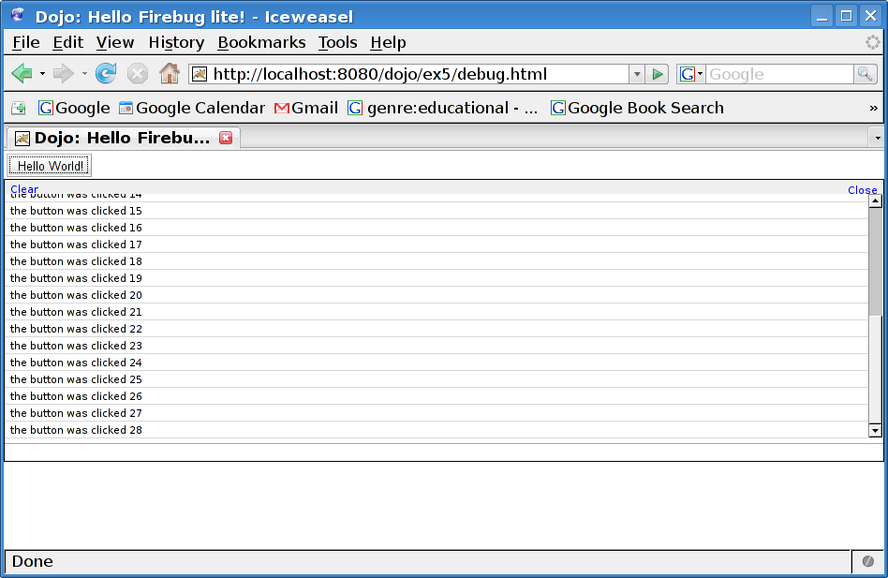
Firebug lite (result)‏

Slide 29
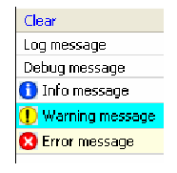
Log severities
Firebug Lite allows you to assign severities to log messages:
  LOG – console.log()‏
  DEBUG – console.debug()‏
  INFO – console.info()‏
  WARNING – console.warn()‏
  ERROR – console.error()‏

Slide 30
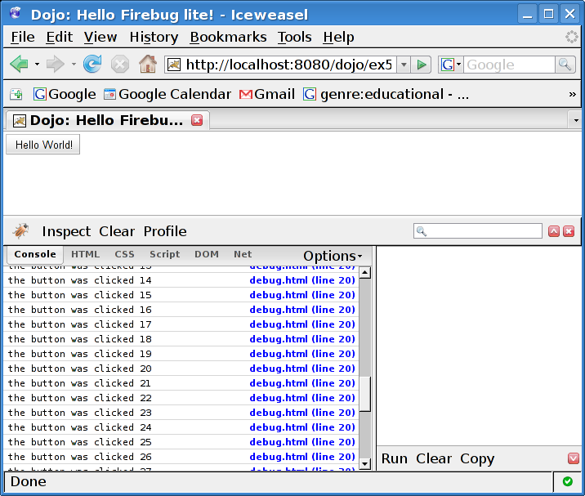
Firebug lite and firebug
Firebug lite uses firebug if enabled:

Slide 31
Mozilla/firefox debugging
The built-in DOM inspector tool is useful to inspect and manipulate the DOM tree.
Web Developer Tool. http://chrispederick.com/work/web-developer/
Fire Bug - Has many useful tools including a simple debugger. https://addons.mozilla.org/firefox/1843/.

Slide 32
Mozilla/firefox debugging
Venkman - JavaScript debugger for FireFox.
http://getahead.ltd.uk/ajax/venkman.

Slide 33
IE debugging
Visual Web Developer Express - A free development tool that contains a good JavaScript debugger. http://www.microsoft.com/express/vwd/.
IE DOM Inspector. Commercial tool. http://www.ieinspector.com/dominspector/.
Internet Explorer Developer Toolbar. Helps you inspect CSS rules and DOM tree.

